Slide 1
The Imageboard World
A presentation by an anonymous *channer

Slide 2
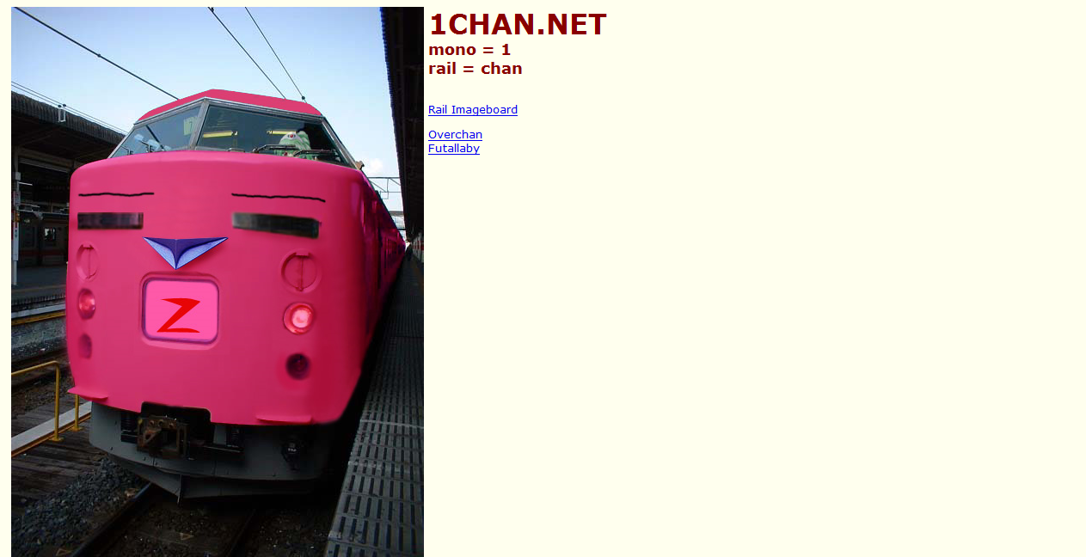

Slide 3
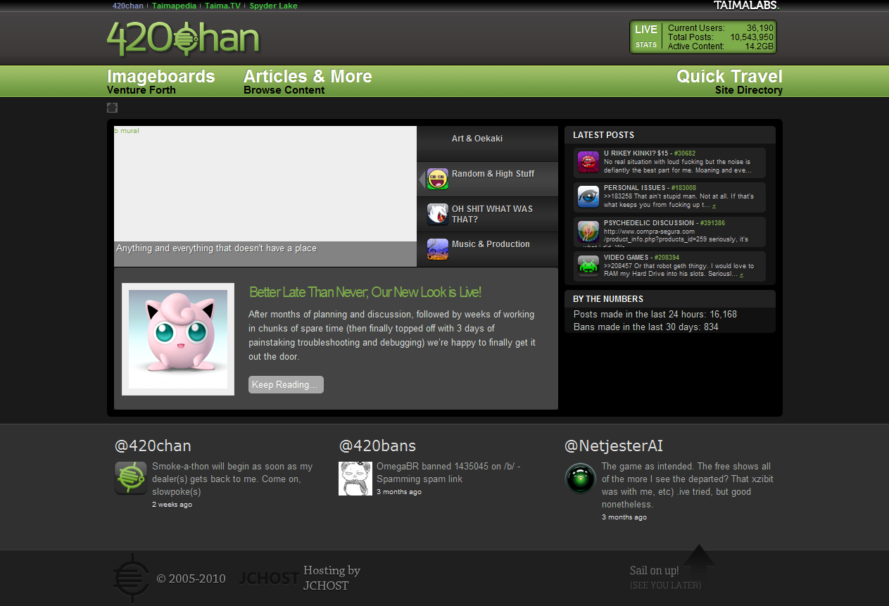

Slide 4
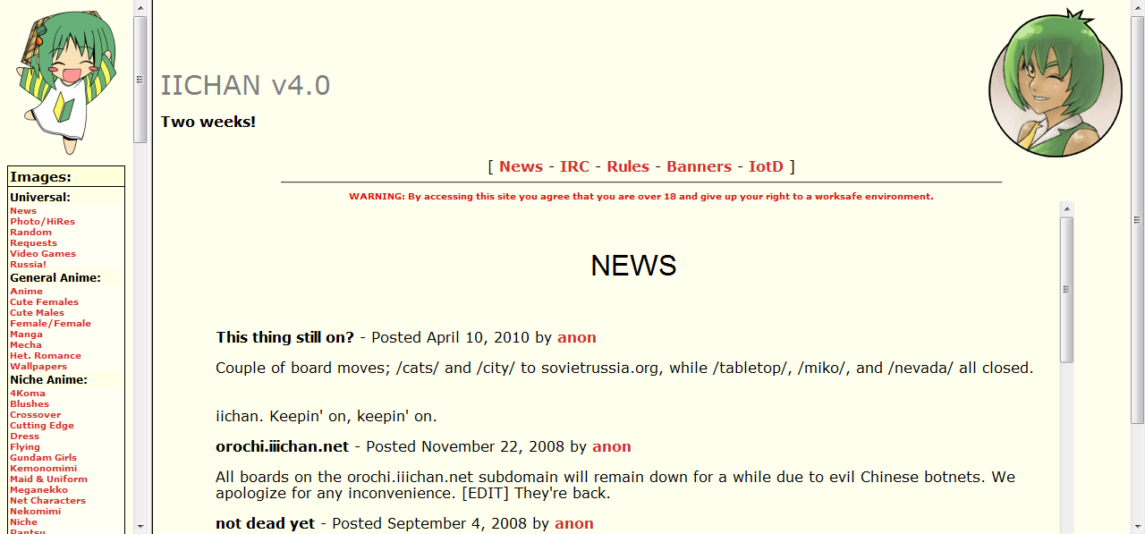

Slide 5
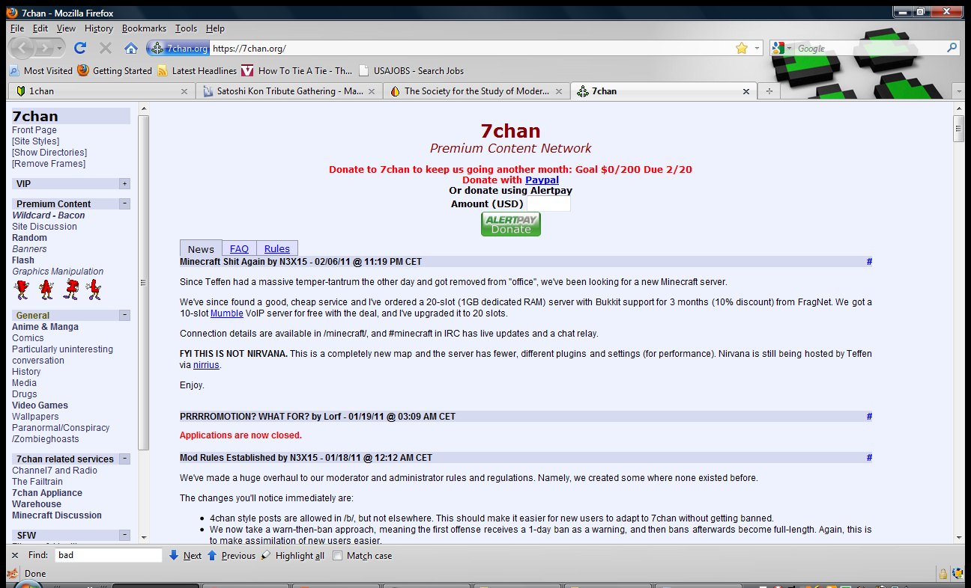

Slide 6
Imageboards
Barrier Free
Media/Message Centered
Nameless Expression

Slide 7
Western Forums
Forced logged in
Person centered
Regular Expression

Slide 8
The long history of imageboards
First Generation: Ayashii and Amezou
Second Generation: 2channel
Third Generation: 2chan
Fourth Generation: 4chan

Slide 9


Slide 11
FUCK THIS SHIT! FUCK POWERPOINT FOR NOW

Slide 12
Stages of a Channer

Slide 13
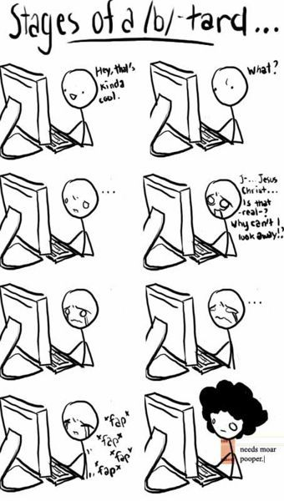

Slide 14
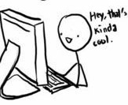
Discovery
First discovers an imageboard, such as 4chan.
Either goes through /b/ or through another board
Discovers cool shit, proceeds to lurk

Slide 15


Lurking
Person begins to lurk moar so he can getting learn how the culture ticks.
Unless the channer has to (like for obvious stupidity on a thread or misinformation) he does not post.
This phase may last from a few days to up to month depending on the imageboard

Slide 16

Passive or Hiveminding
Channer stats posting anonymously.
Begins to fit into the culture
Replies can range from regular replies to well anything.

Slide 17

Active
Then user makes threads to the board.
Creates original content such as image macros, shoops, infographics, or panels.
At this point he can continue to be an anonymous channer or be name/tripfags if he provides useful contribution to the site

Slide 18

Auxialization
Later as he more comfortable to imageboard culture, he loses interest in Western Boards
Finds them either toxic due to the login structure.
From light use to total abandonment.

Slide 19

Depriotizing
In serious cases, the person may depriotise the same topics he does to the topic of the board
Discussing anime more than watching
Discussing video games more than playing them
And so on, and so on and so on.

Slide 20

Channer Persona Manifestation
Were the channer manifest his channer persona outward.
Some subtile, while other keep it to themselves.
While other do it via buttons, sprouting memes to people who are into the same culture
Even cosplay

Slide 21
Why People Get Converted to Imageboards
Unique contribution culture
Recurrency of topics
Near-freedom of speech.

Slide 22


